Slide 1


DEPLOYING STATIC WEBSITE USING LOAD BALANCER BY ARM TEMPLATE
GROUP NO: 23
21891A05I5 - TARAI PRIYANKA 21891A6680 - GANJI BHAVANA 21891A66C9 - YARLAGADDA JASMITHA 21891A66C1 - SUBHANPURAM THANVI SREE

Slide 2

Project Overview
OBJECTIVE:
To deploy a static pet shop website using the Azure ecosystem. By using an Azure Load Balancer and ARM templates, the project aims to ensure:
• • •
KEY CONCEPTS:
1.Static Website Hosting: Using HTML templates (e.g., the uploaded pet shop website) hosted in Azure Blob Storage or VMs.
2.Load Balancer: Routes tra ic to multiple VM instances hosting the static website, ensuring continuous availability.
3.ARM Templates: JSON-based templates used to define the Azure resources in a repeatable and automated way.
WORKFLOW:
1.Create an ARM template for deploying required Azure resources:
High availability of the website. Tra ic distribution for scalability and resilience. Automated infrastructure deployment using Infrastructure as Code (IaC).
•
•
•
Storage Account
Virtual Machines (VMs)
Load Balancer
2.Deploy the ARM template using Azure CLI or Azure Po al.
3.Host the static pet shop website on the VMs.
4.Configure Load Balancer to handle tra ic distribution.

Slide 3


Implementation
☐
ARM Template Creation:
• •
Define resources (Storage Account, VMs, Load Balancer) in a JSON template. Specify parameters like location, resource names, and VM prope ies.
☐
Deployment:
•
Deploy the ARM template using Azure CLI:
az group create --name MyResourceGroup --location centralindia az deployment group create --resource-group MyResourceGroup --template-file template.json.
•
Ensure all resources are successfully created in the Azure Po al.
☐
Website Configuration:
• •
Upload the static HTML files (pet shop website) to the Storage Account or configure it on VMs. Map the Load Balancer to the VM instances hosting the website.
☐
Validation:
•
Test the website by accessing the Load Balancer's public IP or DNS.

Slide 4


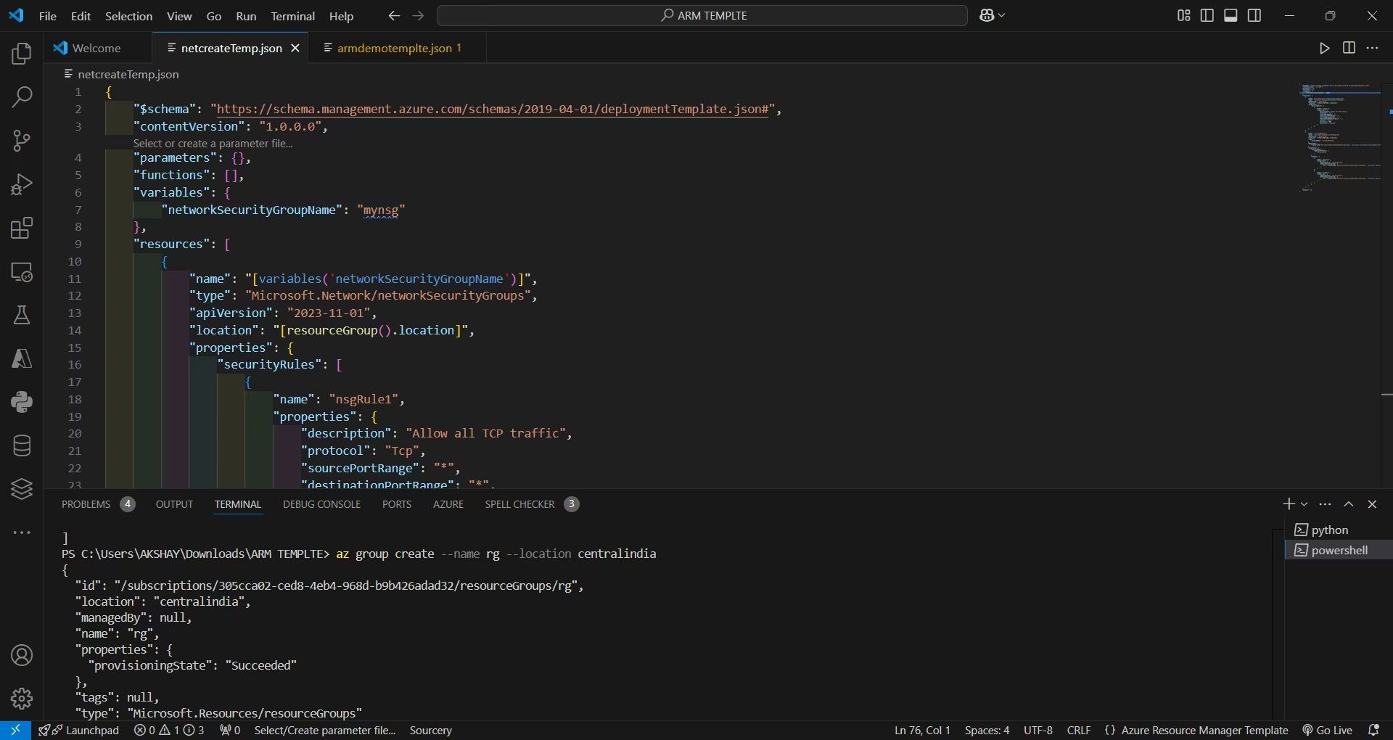

ResourceGroup Creation
COMMAND OUTPUT

Slide 5

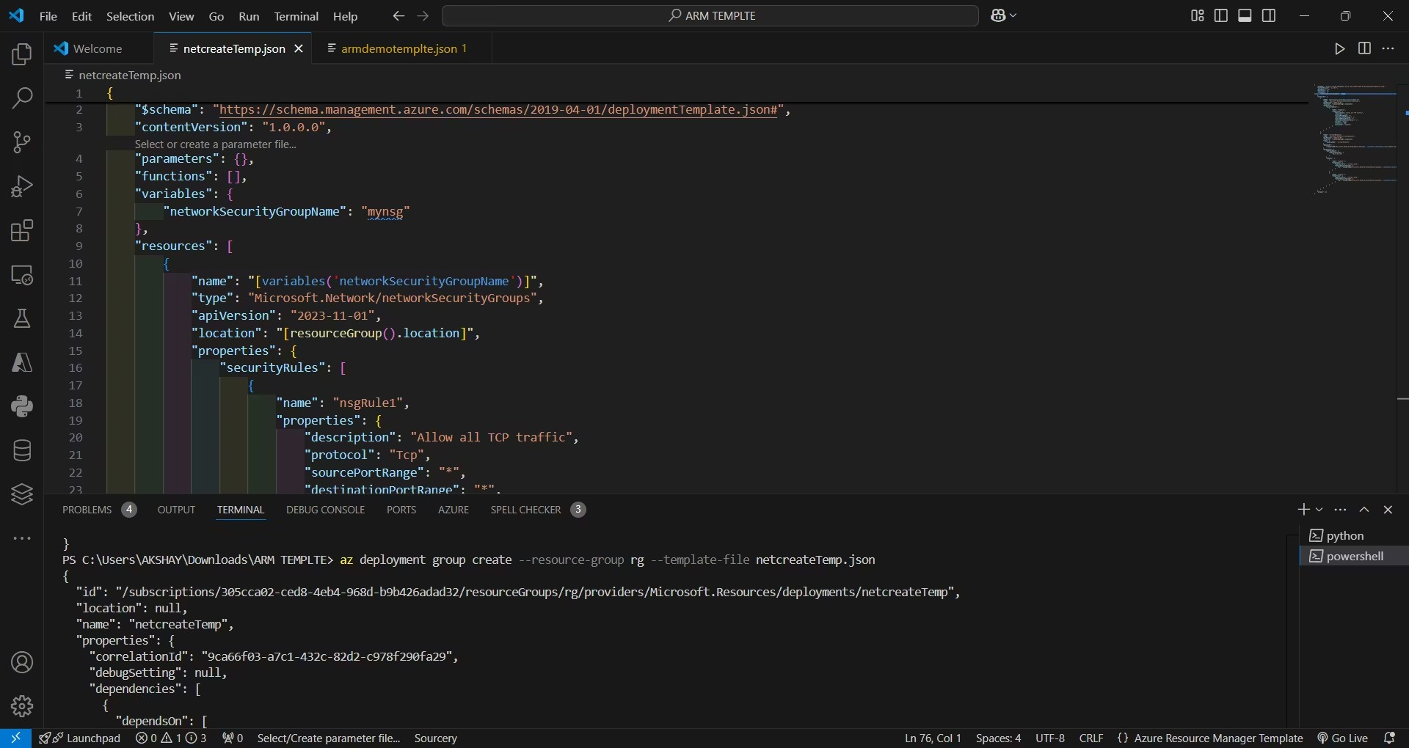

ResourceGroup Deployment
COMMAND OUTPUT

Slide 6
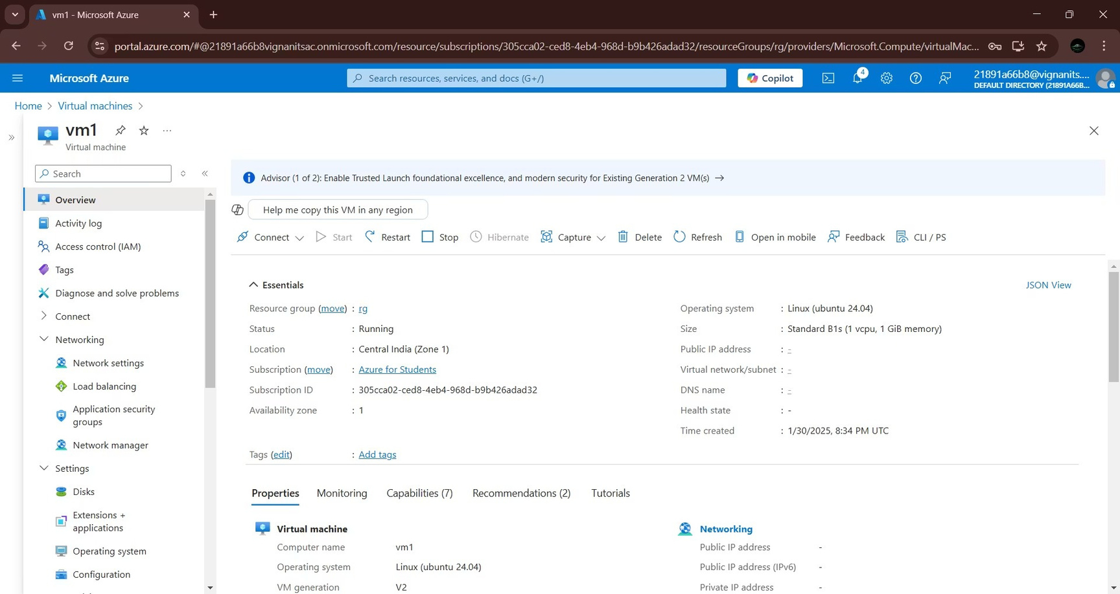
Virtual Machines Deployment
VM1
CUSTOM SCRIPT
#!/bin/bash sudo apt update sudo apt install nginx git -y cd /tmp && git clone h ps://github.com/TaraiPriyanka/ arm_template.git mysitee sudo rm - /var/www/html/index.nginx- debian.html sudo cp -r /tmp/mysitee/* /var/www/html

Slide 7
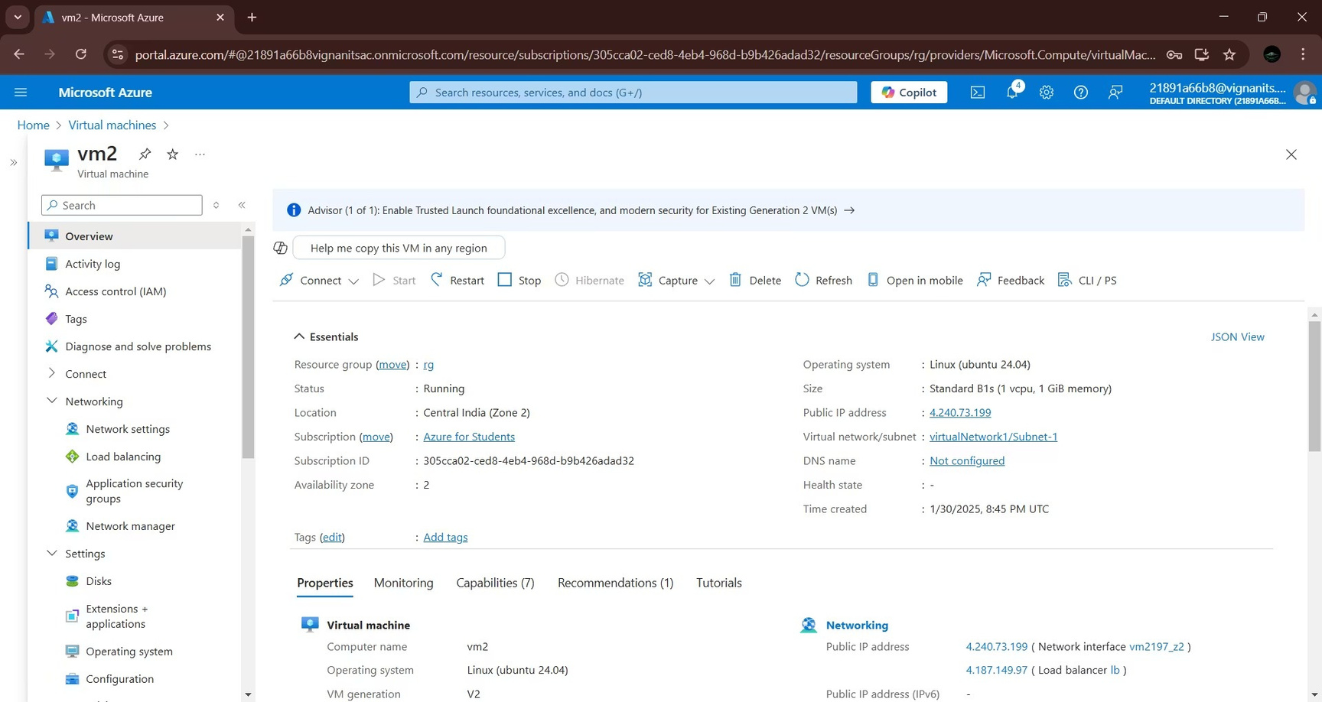
Virtual Machines Deployment
VM2
CUSTOM SCRIPT
#!/bin/bash sudo apt update sudo apt install nginx git -y cd /tmp && git clone h ps://github.com/TaraiPriyanka/ arm_template.git mysitee sudo rm - /var/www/html/index.nginx- debian.html sudo cp -r /tmp/mysitee/* /var/www/html

Slide 8
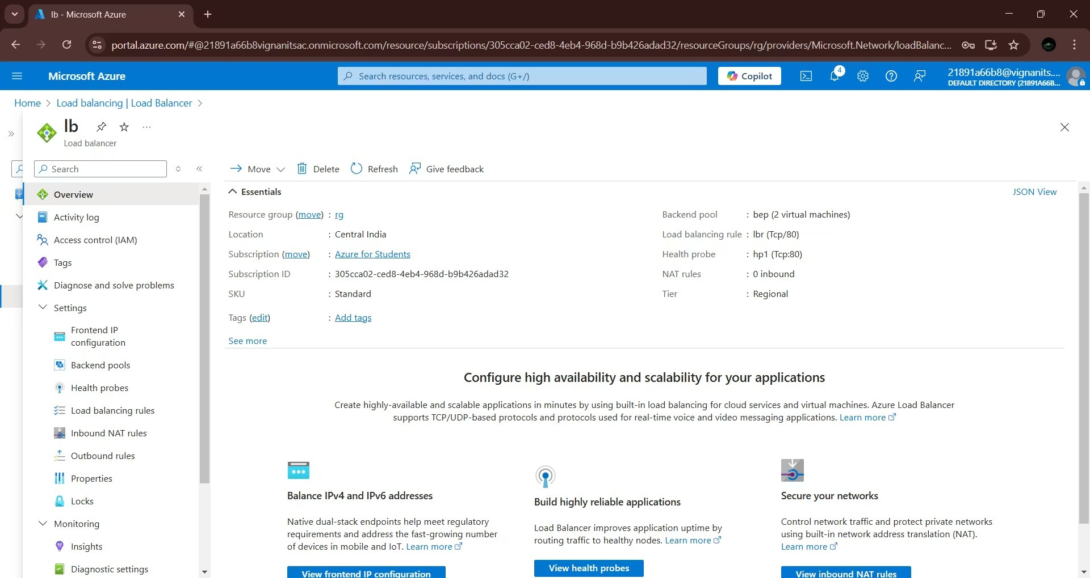
Load Balancer Deployment

Slide 9

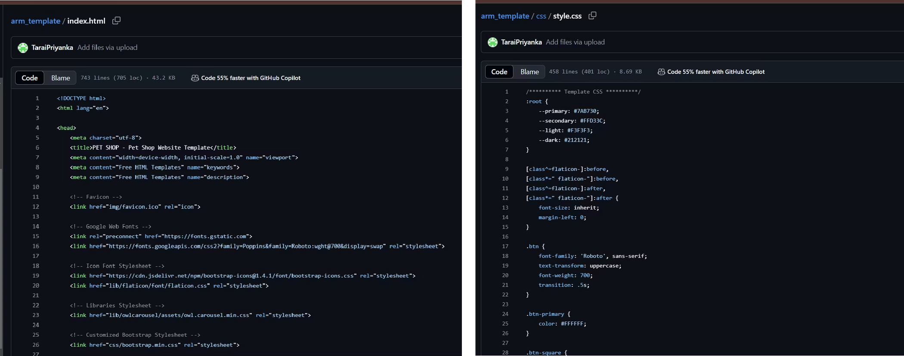

Code
HTML
CSS

Slide 10
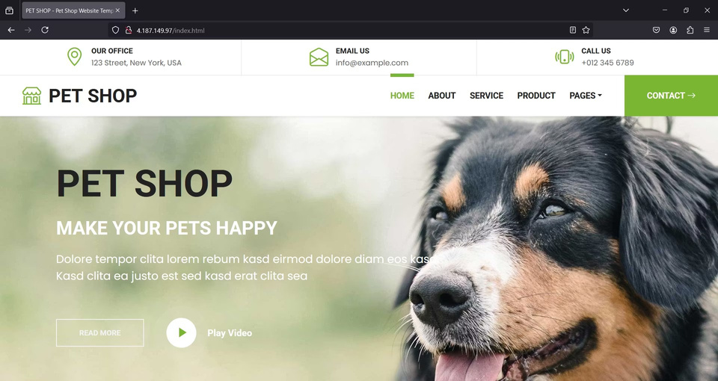
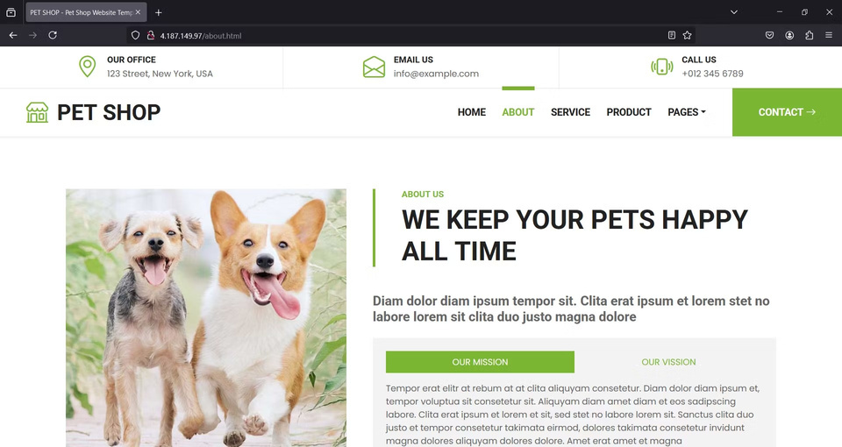
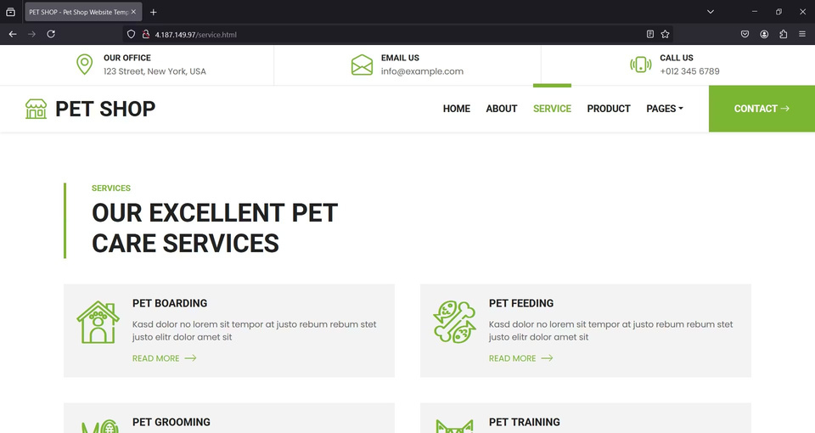
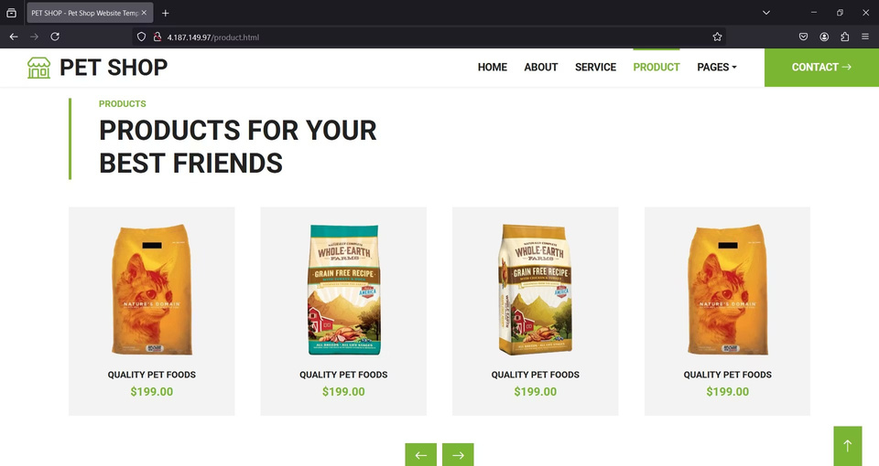
Website
HOME
ABOUT
SERVICES
PRODUCT

Slide 11

Conclusion
Successfully deployed a highly available static website using:
•
•
Azure Load Balancer for traffic distribution.
ARM templates for automated and repeatable deployments.
Ensured:
•
•
Scalability of the application.
Improved disaster recovery by hosting on multiple VMs.
Highlighted the potential of Infrastructure as Code (IaC) for deploying cloud
resources ef ciently.

Slide 12

THANK
YOU

